Slide 1


Slide 2

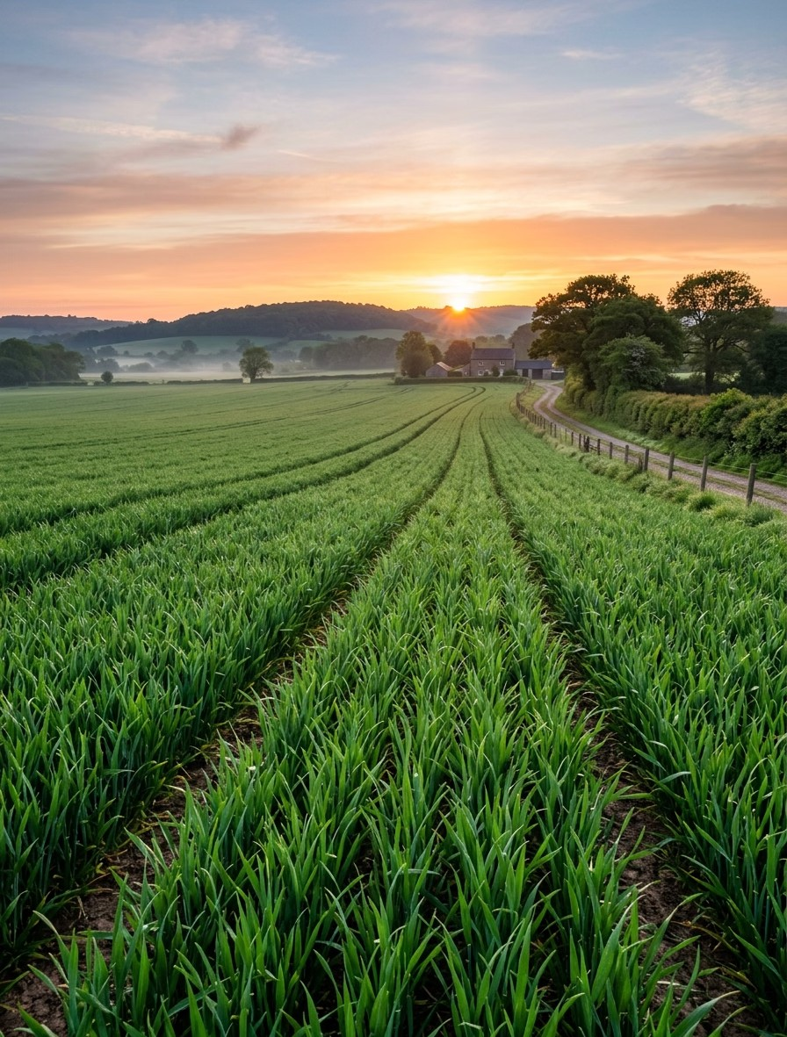
AI-Based Crop Recommendation for Farmers
DTIE · IDEA EXPO
Data-informed decisions for every growing season
Section : 13
DTIE Project Group : 11

Slide 3
Team Members
PROJECT TEAM
B.Rishith 2620030021
K.Aditya 2620090002
N.Varun 2620040048
Sri Vishwa Chaitanya 2620090036

Slide 4

VISION AND MISSION
VISION
MISSION
Farming decisions that are clearer, more local, and more resilient.
Turn soil, weather, season, and market
signals into practical crop recommendations.

Slide 5
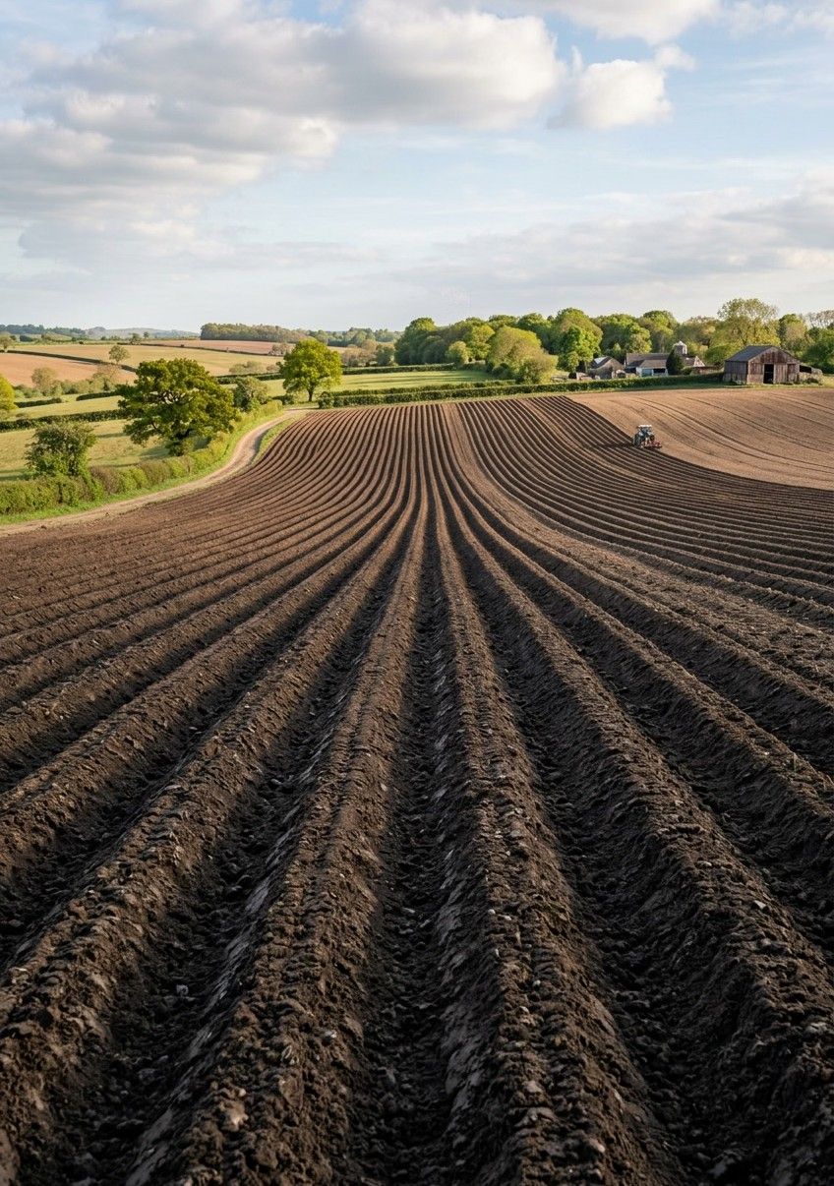
PROBLEM STATEMENT
Farmers often choose crops with incomplete or disconnected information.
Soil and weather variability can change what will grow well, while seasonality and market uncertainty can increase financial risk.
The gap: one practical view of the signals that shape a planting decision.
DTIE | Department of Multi Disciplinary Innovation & Entrepreneurship

Slide 6
What the study should examine
RESEARCH
01 02
03
Farmers balance soil condition, weather, seasonality, input costs, and market access.
Local knowledge is valuable, but data may be spread across different sources.
Interviews, field observation, and user testing can validate the highest-value signals.
No invented statistics: validate assumptions with local research.

Slide 7
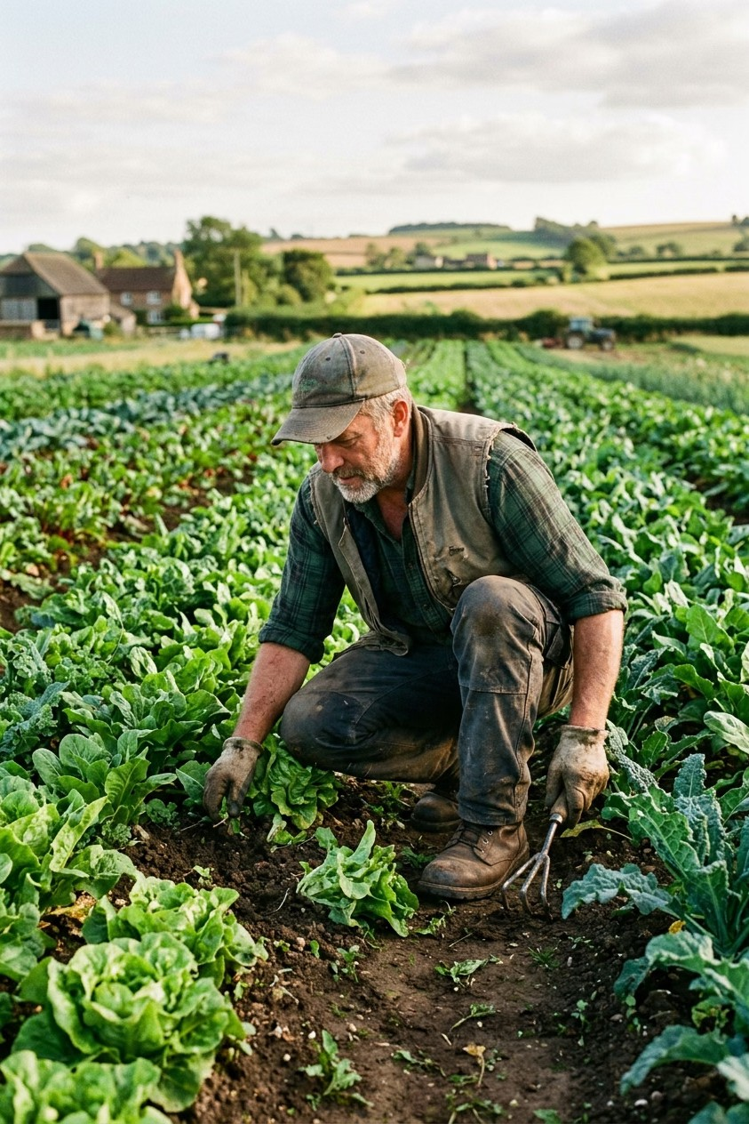
Who we serve
TARGET USER - CUSTOMER
PRIMARY USERS
Smallholder and independent farmers making seasonal planting decisions.
SUPPORTING CUSTOMERS
Agronomists, cooperatives, extension teams, and agri-service partners.
Design priority: clear recommendations, local context, and farmer control.

Slide 8
Alternatives today
BENCHMARKS
Farmer experience and peer advice
Weather, soil, and crop-planning tools
Input suppliers and market-price information
Our benchmark
Be simpler than separate tools and more transparent than a black-box answer.

Slide 9
What could slow us down
RISKS AND GAP
KEY RISKS
Weather uncertainty
Data quality
User trust
Connectivity
CURRENT GAPS
Local datasets, explainable recommendations, and reliable market context may be limited.
Mitigation
Start with transparent assumptions, feedback loops, and human review.

Slide 10
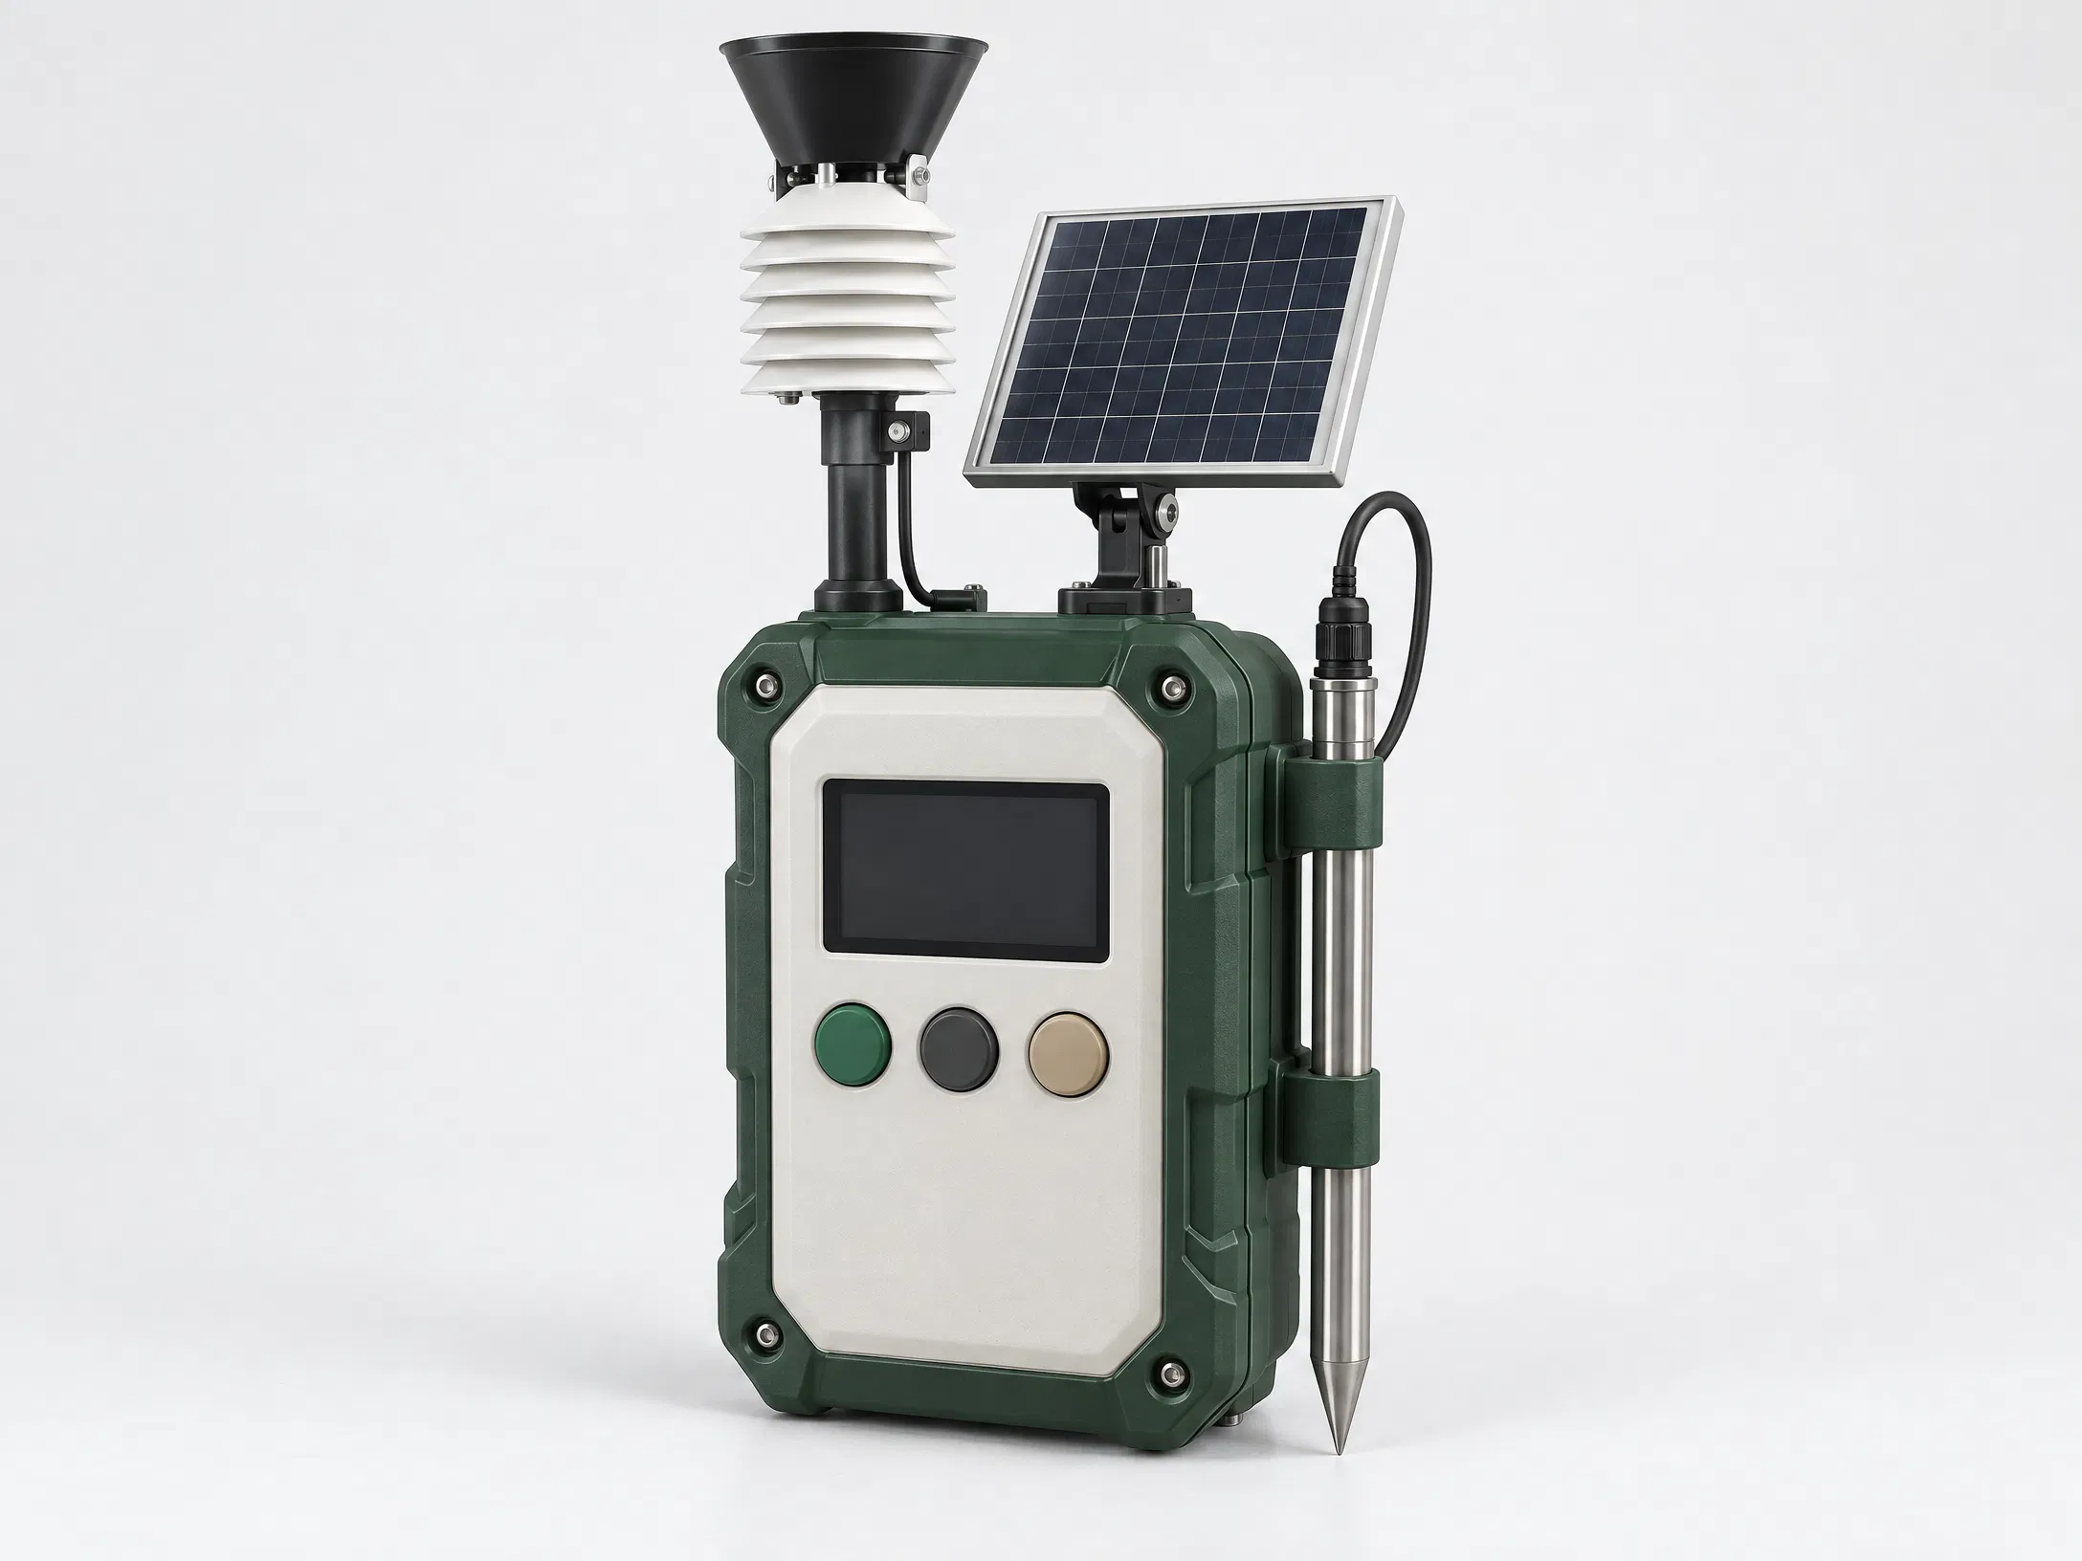
See it in action
PROTOTYPE
AI RECOMMENDATION FLOW
Farmer enters soil, weather, season, and market context; the model compares conditions and explains a shortlist of suitable crops.
WEBSITE:
https://krishiai-darrkr7i.manus.space
Prototype:
https://studio.tripo3d.ai/3d-model/soil-moisture-sensor-device-with-solar-panel-display-control-buttons-01f5ae60-418f-4f0a-a08a-533870f864f2

Slide 11
From field data to planting plan
ARCHITECTURE
1. Input Soil profile ·
weather outlook · season · market context
2. AI analysis Compare conditions, constraints, and crop suitability.
3.
4. Action
Plan planting with local judgment.
Recommendation
Review a ranked shortlist.

Slide 12
Lean Canvas Model
BUSINESS MODEL
Problem Uncertain crop choice and
fragmented signals.
Solution Explainable recommendations from local inputs.
Users
Farmers; partners:
agronomists and cooperatives.
Value
Clearer decisions
with less avoidable risk.
Channels Mobile/web prototype, field partners, referrals.
Metrics Recommendation use, feedback, repeat planning.
Advantage
Transparent, farmer-in-the-loop context.

Slide 13
Funding the first harvest
CAPITAL (FINANCIAL)
EARLY COSTS
Product design, hosting, data access, field research, and partner support.
POTENTIAL MODELS TO TEST
Grant funding, pilot partnerships, or a subscription/service plan.
Assumptions, not actuals
Next step
Validate willingness to pay and build a bottom-up budget before quoting figures.

Slide 14
From seed idea to regional scale
ROADMAP/ TIMELINE
Now
Refine problem, interview users, and validate input needs.
Next
Connect trusted soil, weather, season, and market data.
Pilot
Test recommendations with farmers and capture feedback.
Scale
Improve explainability, partnerships, and regional coverage.

Slide 15
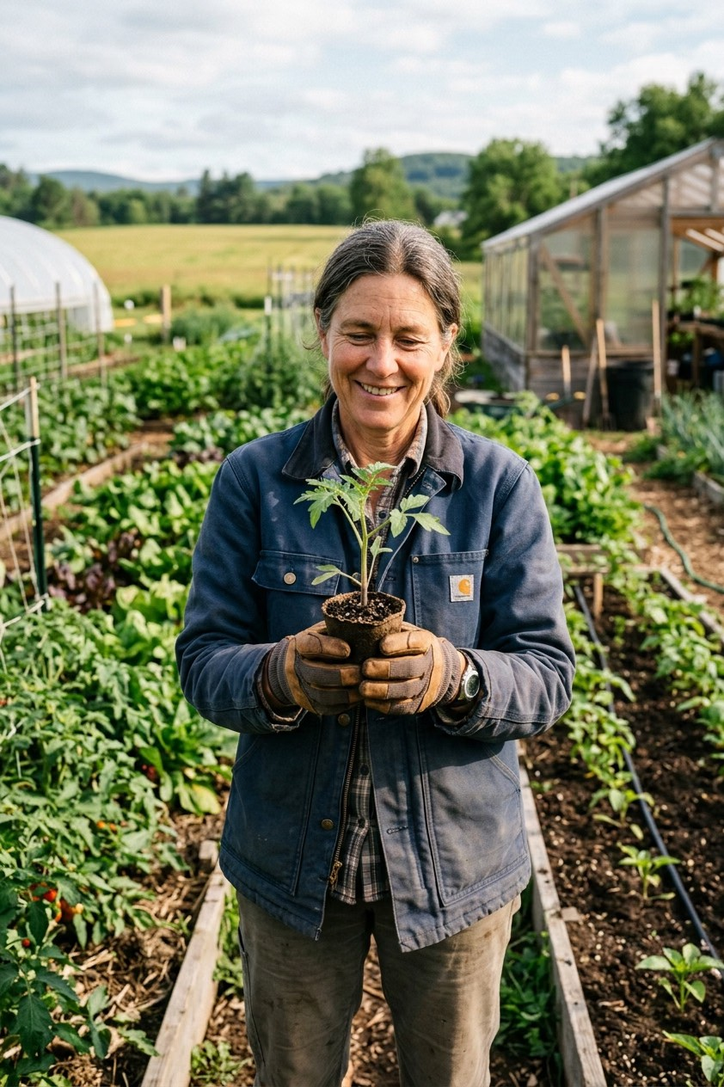
AI-Based Crop Recommendation for Farmers
IN SUMMARY
Turn local growing conditions into a clear crop shortlist.
Keep recommendations explainable and farmer-led.
Validate the idea with local research and field feedback.
Join us in building more confident planting decisions.

Slide 16
THANK YOU

